Slide 1

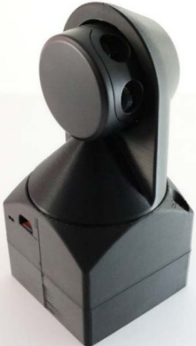
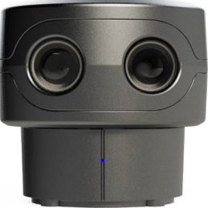
3D Scanning with 2D LIDAR
2D
By: Jared Jess
3D
Notes:
Objective was to test the Scanse Sweep 2D lidar. I decided to make this scanner a 3D scanner.

Slide 2

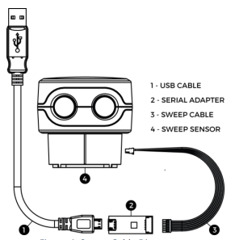
Scanse Sweep V1 LiDAR Sensor
Interface with PC or microcontroller
6 Pin connection & 2 serial port options
360º Horizontal field of view
Status LED to provide operator feedback
Light Detection And Ranging (LiDAR)
Notes:
USB to Serial adaptor for PC
5v / power enable(sleep mode ResPullDown) / Sync (only Active when scanning) / UART Rx / UART Tx / Ground
0.5 deg vertical FoV
Also used for orientation LED = front
Time of flight sensing of Transmitted and Received light/laser to determine range

Slide 3




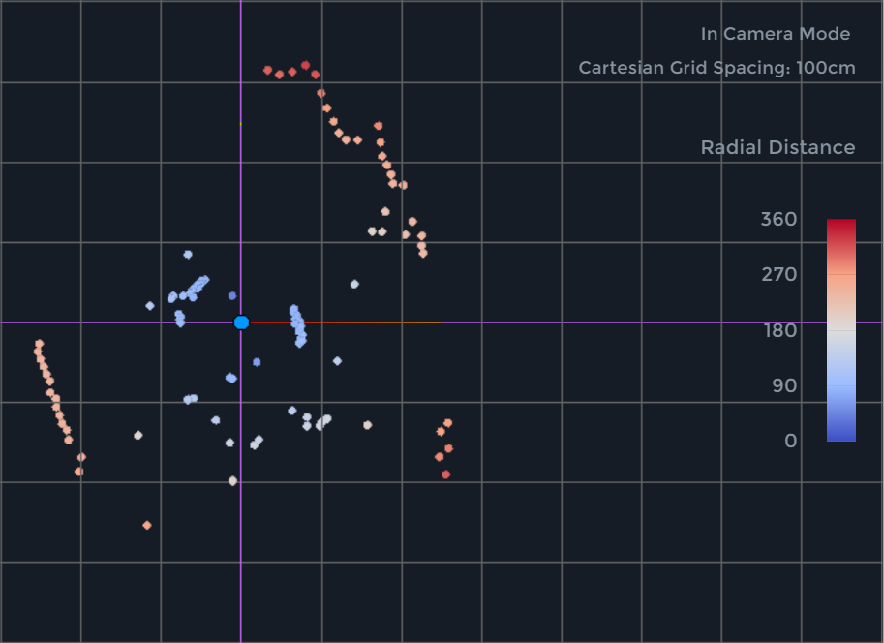
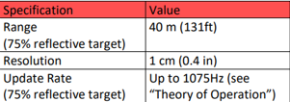
2D LiDAR Scanning
2D Scan of the Desk Space in My Office
360º rotating head for single plane data recording
Uses time of flight ranging method
Utilizes an optical encoder to record angles
Notes:
Head rotates CCW
Transmits light pulses in a unique pattern then receives the light after it bounces off objects
Records the angle of each data point
Note Spec Sheet & 2D Scan.

Slide 4

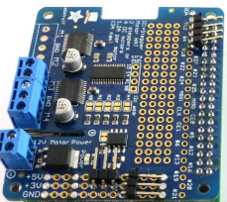

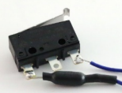
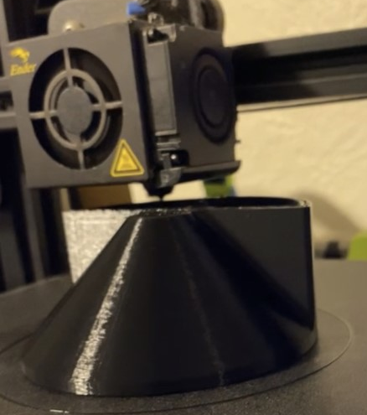
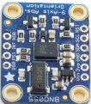
2D to 3D Scanner
First Step: Find a way to mount the 2D scanner so it rotates its head along the Z axis.
Second Step: implement a motor, motor driver/hat, a limit switch, and a 3D printed housing to create a 180º rotating mount.
Third Step: Assemble the system and gather software for operating the system
Notes:
Other Hardware Used: Raspberry Pi, IMU, bearings,10K resistor, and misc wire jumpers and nuts/bolts

Slide 5

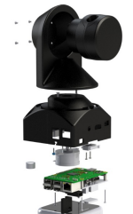
Configuring & Operating the System
Software Requirements
GitHub was a HUGE help!!
Sweep Visualizer
PI3-AP & http://172.24.1.1:8080
Systems Checks!!
Hardware Diagram
Notes:
Just like the JetBot, flash SD
To view the scan for measuring
WIFI communication to operate wirelessly
I had issues with the USB.

Slide 6

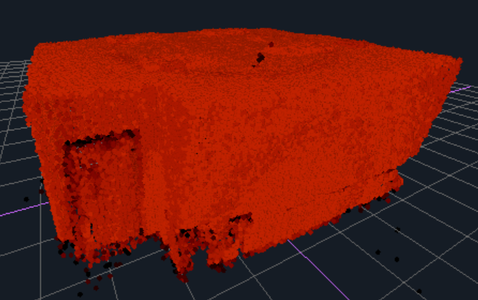
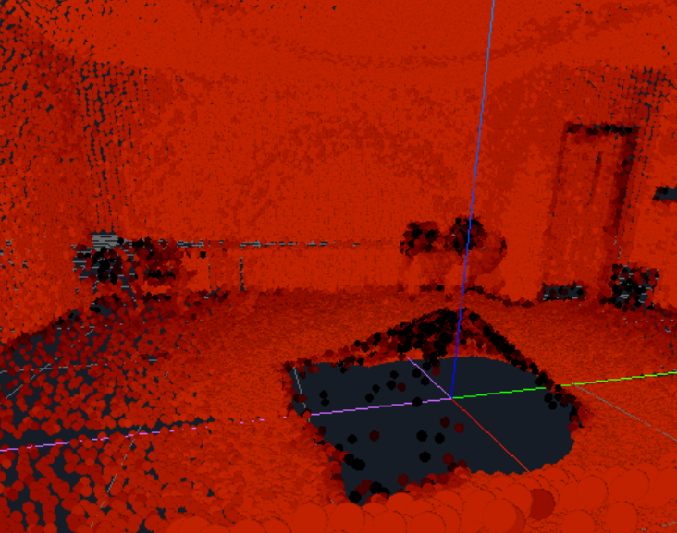
Viewing Scans
Notes:
Open Sweep Visualizer????

Slide 7
Data Analysis
Range: You can see that some of the base caused errors in some of the points.
Resolution: Notice the different heights for the stacked chairs?
Static Error: Errors occurred at the base, the level surfaces(tables), and the non reflective backs of the chairs.
Notes:
Actual dimensions of the Room: 15’ 2’’ X 22’ 6’’ X 9’ 4’’ Doorway Dimensions: 3’ X 5’ 2’’

Slide 8
Summary
The Scanse Sweep V1 is a very nice sensor, even when scanning in 3D. Although I did not get to test its maximum range of 40m (131ft), I have confidence that this sensor will show findings that align with the accuracy of the datasheet.

Slide 9

Questions??

